Slide 1

Solving the Schrodinger Equation on a Computer with the Numerov Procedure

Slide 2
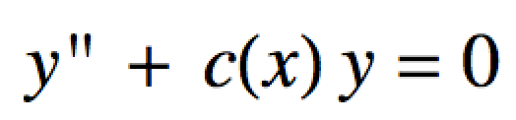
Numerov Procedure
The Numerov algorithm can be used to solve diff. eqs of the form:
It’s important to us since our Schrodinger equations have this form.

Slide 3
Numerov Procedure
The algorithm “solves” the diff. eq iteratively as it works its way across the x-axis
Choose a potential energy function V(x)
Our choices are:
“box” for particle in a box
“harmonic” for harmonic oscillator
“anharmonic” for anharmonic oscillator
“radial” for hydrogen-like radial wave functions

Slide 4
Numerov Procedure
Guess an initial value for the energy E.
Set up an x-axis:
Choose an increment dx as well as an xmin and xmax.
xmin and xmax should span a distance where the wave function will be mostly non-zero
It helps to look at a graph of your V(x) to figure out about what xmin and xmax should be for a given guess E.

Slide 5
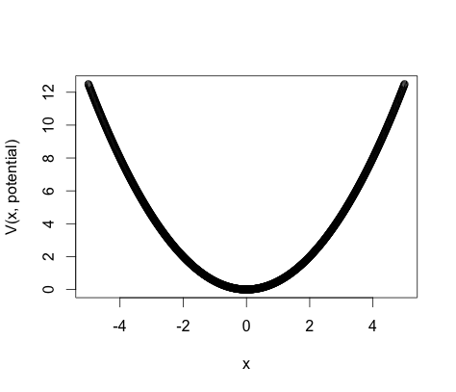
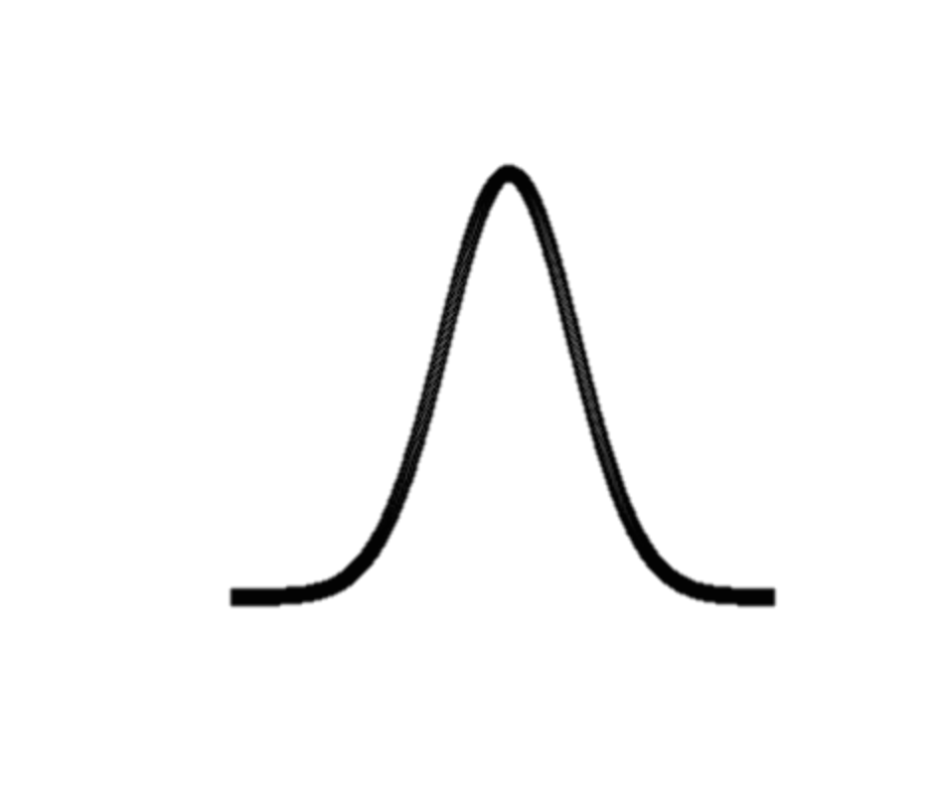
Numerov Procedure
ψ₀
Wave function tails should be around here
Say we guess an energy, E in this neighborhood
Guess xmin and xmax at least around here

Slide 6
Numerov Procedure
Input the desired number of nodes in ψ(x).
This gives the state.
Need to know the first two solution points ψ(x₁) and ψ(x₂)
We always make ψ(x₁) and ψ(x₂) ≈ 0 because of the boundary conditions
Once we have ψ(x₁), ψ(x₂), V(x) and a guess for E the algorithm can compute a ψ(x).
We check that ψ(x) has the requested number of nodes and that ψ(xmax) ≈ 0
If not, guess another E and repeat.

Slide 7

Handy Commands:
source() function:
Loads an R-program in another file
Use it two ways:
source(file.choose()) opens up a dialog box where you can navigate to the file to load
source(“your-file-path-here”) to load the file directly via its path.

Slide 8
Numerov.functions.R:
The Numerov algorithm is programmed in the file Numerov.functions.R
Within Numerov.functions.R there a two functions we will use:
numerov.procedure(xaxis, dxaxis, PE.function.name, nodes.in.state, E.guess, num.iterations, delay.time)
approx.normalize(wf.info, plotQ=FALSE)
We will use these functions in the Numerov-control_script.R script
To use these functions we must source Numerov.functions.R

Slide 9
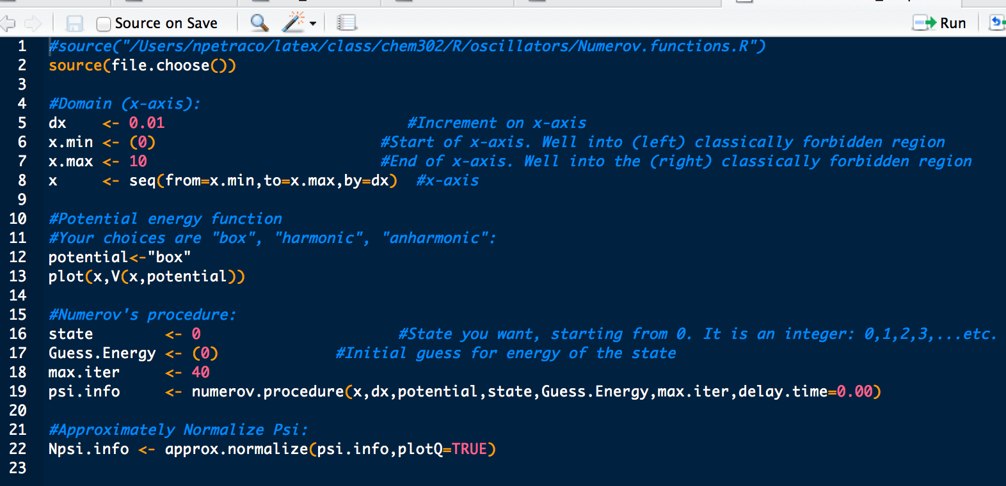
Numerov-control_script.R:

Slide 10
Numerov.functions.R:
The output of both numerov.procedure and approx.normalize is a two-column matrix:
Column 1 is the x-axis used to compute the wave function
Column 2 is the computed wavefunction values
Using psi.info, how could you plot the wave function?
How could you plot the normalized wave function?

